Slide 1

以週期性晶疇極化反轉鈦擴散式鈮酸鋰波導絕熱耦合器作為全光開關之研究 Non-phase-matched all optical switching based on stimulated Raman adiabatic passage in Ti-diffused periodically poled lithium niobate waveguides
學生:葉冠廷
指導教授:陳彥宏 博士
Notes:
This topic just a tentative name .
I divide my work into three parts .

Slide 2
Outline
History
Motivation
Principle
Stimulation
Result
Conclusion
Future work

Slide 3
History
History
1917
1951
1961
now
Stimulated emission
Spontaneous emission
Absorption
Population inversion
Ruby Laser
Nonlinear Optics

Slide 4
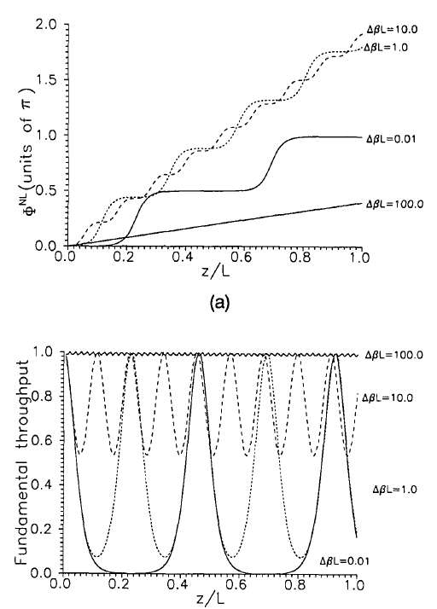
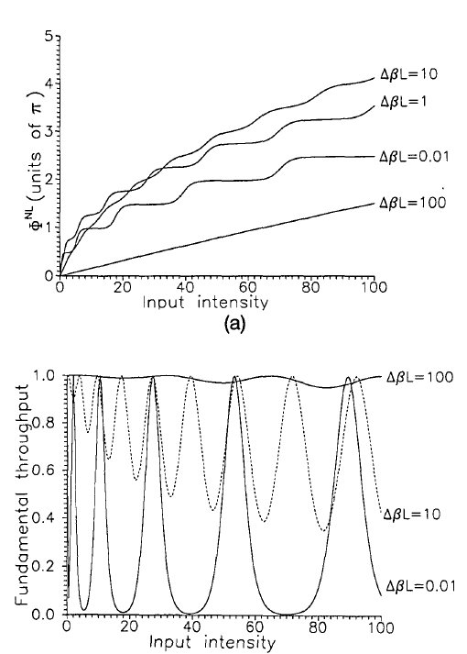
History
History
George I. Stegeman, Mansoor Sheik-Bahae, Eric Van Stryland, Gaetano Assanto, Large nonlinear phase shifts in second-order nonlinear-optical processes, Optics Letters , 18(1), 13, 1993

Slide 5
History
History
D. C. Hutchings, J. S. Aitchison, C. N. Ironside, All-optical switching based on nondegenerate phase shifts
from a cascaded second-order nonlinearity, Optics Letters , 18(10), 793, 1993

Slide 6
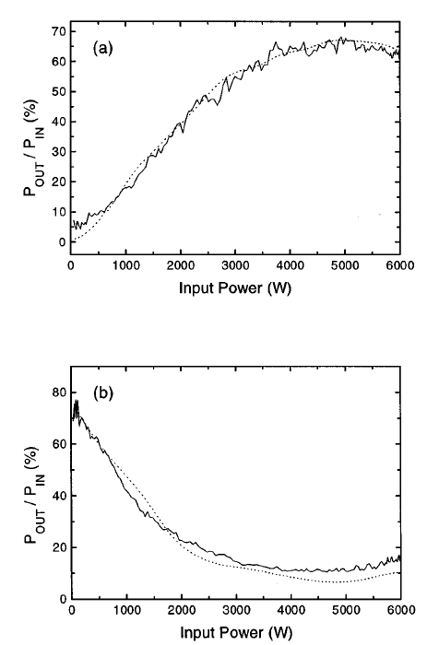
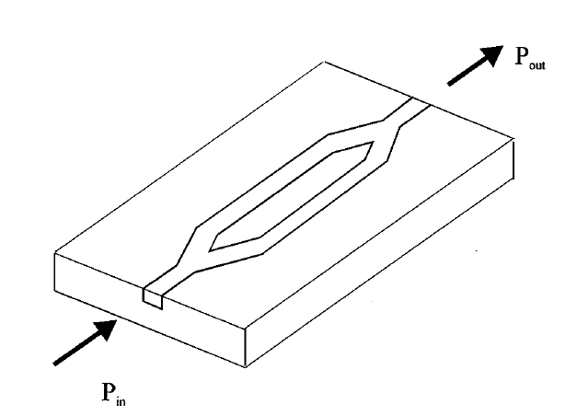
History
History
Y. Baek, R. Schiek, G. I. Stegeman, G. Krijnen, I. Baumann, W. Sohler , All‐optical integrated Mach–Zehnder switching due to cascaded nonlinearities, Applied Physics Letters , 68(15), 2055 - 2057, 1996

Slide 7
History
History
R. Schiek, L. Friedrich, H. Fang, G. I. Stegeman, K. R. Parameswaran, M.-H. Chou, M. M. Fejer, “Nonlinear directional coupler in periodically poled lithium niobate”, Optics Letters , 24(22), 1617, 1999

Slide 8
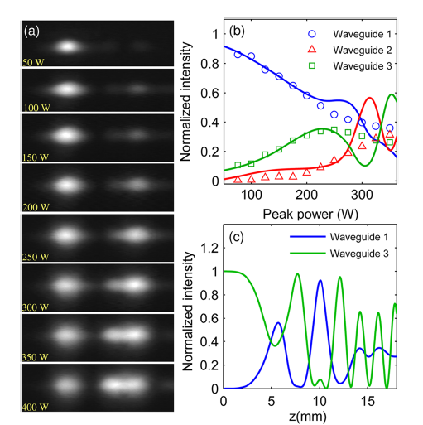
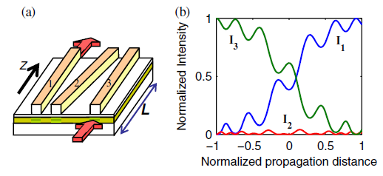
History
History
Y. Lahini, F. Pozzi, M. Sorel, R. Morandotti, D. N. Christodoulides, Y. Silberberg, Effect of Nonlinearity on Adiabatic Evolution of Light, Physical Review Letters , 101(19), 2008

Slide 9
Motivation
Motivation
Periodically Poled Lithium Niobate
Adiabatic Coupler

Slide 10


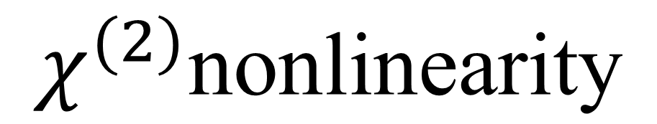

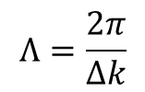



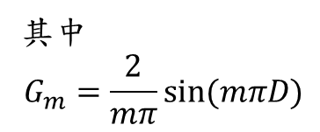

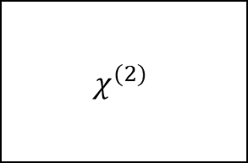

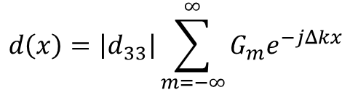
$$χ^{(2)}\text{nonlinearity}$$
Principle
Momentum conservation:
Quasi-phase matching:
$${\overset{⃑}{k}}_{ω_{1}}$$
$${\overset{⃑}{k}}_{ω_{2}}$$
$$Δk$$
$$χ^{(2)}$$
$$ω_{1}$$
$${\overset{⃑}{k}}_{ω_{3}}$$
$$ω_{3}$$
$$ω_{2}$$
$$d\left(x\right)=\left|d_{33}\right|\sum_{m=−∞}^{∞}{G_{m}e^{−jΔkx}}$$
Energy conservation
Momentum conservation
其中
$$G_{m}=\frac{2}{mπ}sin⁡(mπD)$$
$$Λ$$
$$Λ=\frac{2π}{Δk}$$

Slide 11
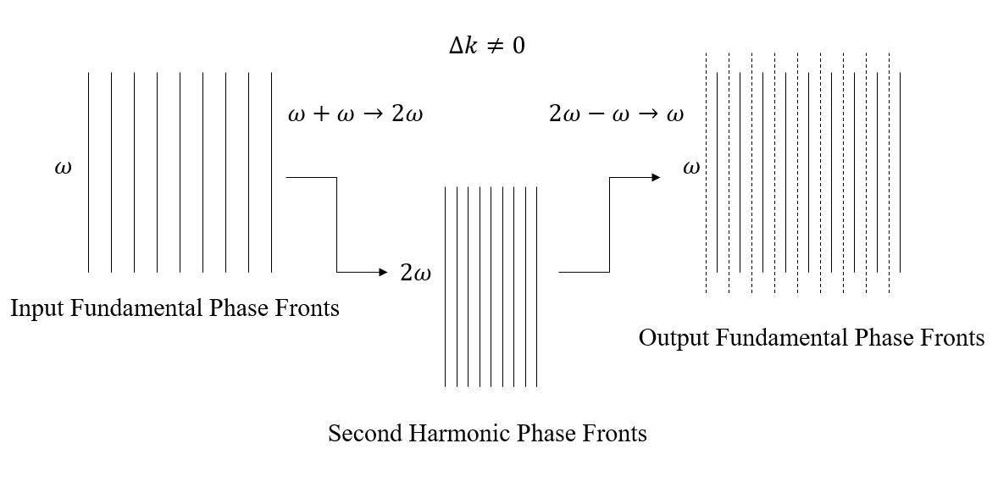
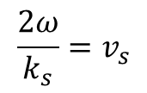



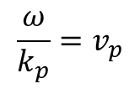

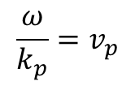

$$χ^{(2)}\text{nonlinearity}$$
Principle
Second Harmonic Generation (SHG):
$$\frac{ω}{k_{p}}=v_{p}$$
$$\frac{ω}{k_{p}}=v_{p}$$
$$∆∅$$
$$ω+ω→2ω$$
$$\frac{2ω}{k_{s}}=v_{s}$$
$$2ω−ω→ω$$
$$\frac{l_{c}}{2}$$
$$\vec{E}=E_{0}cos⁡(ωt−kx+∆∅)$$

Slide 12

$$χ^{(2)}\text{nonlinearity}$$
Principle
Kerr effect$:n=n_{o}+n_{2}I$
Cascaded nonlinearity

Slide 13
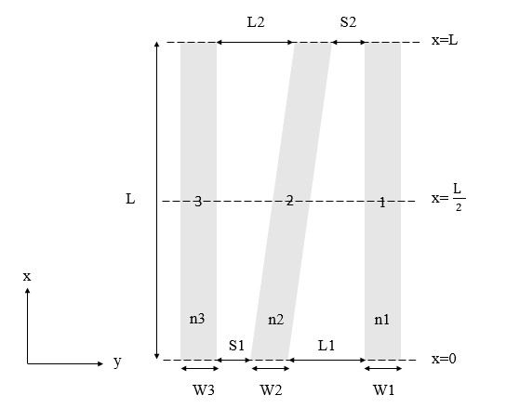
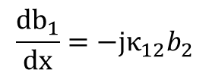

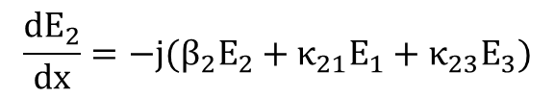
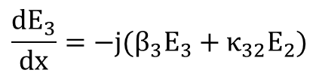
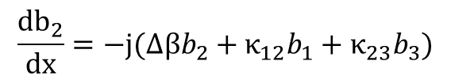
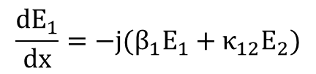
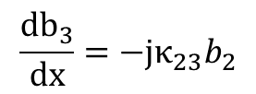
Adiabatic coupler
Principle
Coupled mode equation:
$$\frac{dE_{1}}{dx}={−j(β_{1}E}_{1}+κ_{12}E_{2})$$
$$\frac{dE_{2}}{dx}={−j(β_{2}E}_{2}+κ_{21}E_{1}+κ_{23}E_{3})$$
$$\frac{dE_{3}}{dx}={−j(β_{3}E}_{3}+κ_{32}E_{2})$$
${(E}_{n}=b_{n}e^{−iβx} , n=1,2,3 ,β_{1}=β_{3}=β)$
$$\frac{db_{1}}{dx}=−jκ_{12}b_{2}$$
$$\frac{db_{2}}{dx}=−j(∆βb_{2}+κ_{12}b_{1}+κ_{23}b_{3})$$
$$\frac{db_{3}}{dx}=−jκ_{23}b_{2}$$

Slide 14
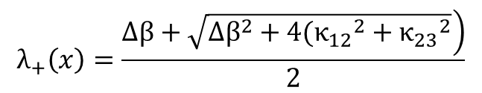
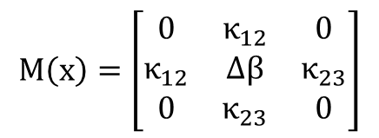

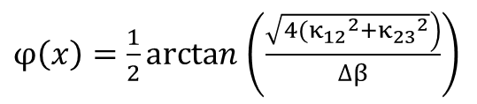

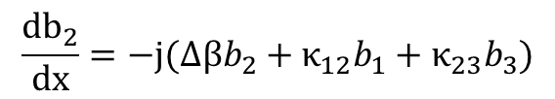
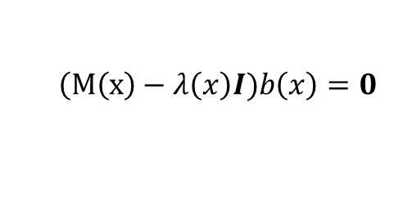
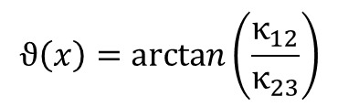
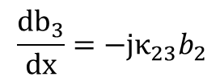
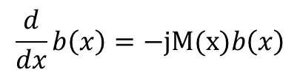
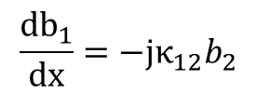
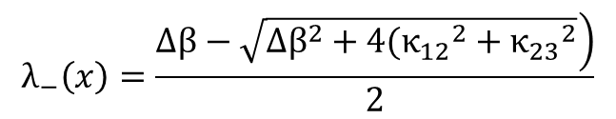
Adiabatic coupler
Principle
Eigen value:
$$\frac{db_{1}}{dx}=−jκ_{12}b_{2}$$
$$λ_{0}\left(x\right)=0$$
$$\frac{db_{2}}{dx}=−j(∆βb_{2}+κ_{12}b_{1}+κ_{23}b_{3})$$
$$λ_{+}\left(x\right)=\frac{\left.∆β+\sqrt{{∆β}^{2}+4({κ_{12}}^{2}+{κ_{23}}^{2}}\right)}{2}$$
$$\frac{db_{3}}{dx}=−jκ_{23}b_{2}$$
$$λ_{−}\left(x\right)=\frac{\left.∆β−\sqrt{{∆β}^{2}+4({κ_{12}}^{2}+{κ_{23}}^{2}}\right)}{2}$$
Description of matrix:
Eigen state:
$$\frac{d}{dx}b\left(x\right)=−jM(x)b\left(x\right)$$
$$ϑ\left(x\right)=arctan\left(\frac{κ_{12}}{κ_{23}}\right)$$
$φ\left(x\right)=\frac{1}{2}arctan$ $\left(\frac{\left.\sqrt{4({κ_{12}}^{2}+{κ_{23}}^{2}}\right)}{∆β}\right)$
$$M\left(x\right)=\left[\begin{matrix}0 & κ_{12} & 0 \\ κ_{12} & ∆β & κ_{23} \\ 0 & κ_{23} & 0\end{matrix}\right]$$
$$ψ_{0}\left(x\right)=cosϑ\left(x\right)｜1⟩−sinϑ\left(x\right)｜3⟩$$
$$ψ_{+}\left(x\right)=sinϑ\left(x\right)sinφ\left(x\right)｜1⟩+cosφ\left(x\right)｜2⟩+cosϑ\left(x\right)sinφ\left(x\right)｜3⟩$$
$$\left(M\left(x\right)−λ\left(x\right)I)b\left(x\right)=0\right.$$
$$ψ_{−}\left(x\right)=sinϑ\left(x\right)cosφ\left(x\right)｜1⟩−sinφ\left(x\right)｜2⟩+cosϑ\left(x\right)cosφ\left(x\right)｜3⟩$$

Slide 15
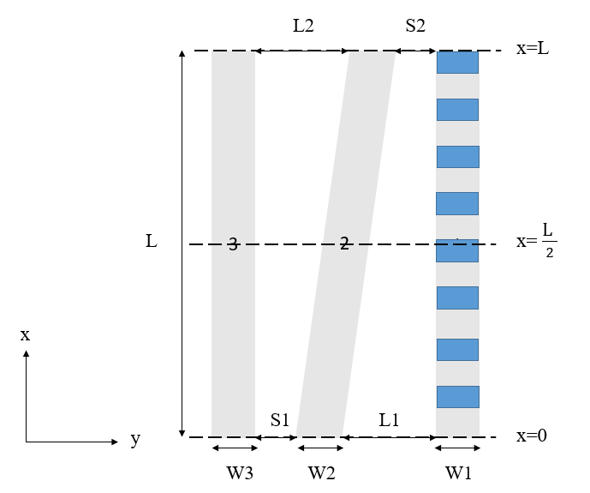
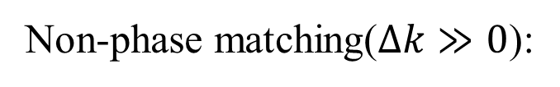
Adiabatic coupler + PPLN
Principle
Non-phase matching($∆k≫0$):

Slide 16
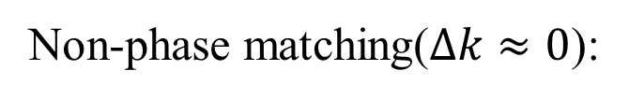
Adiabatic coupler + PPLN
Principle
Non-phase matching($∆k≈0$):

Slide 17
Stimulation
Stimulation

Slide 18
Result

Slide 19
Conclusion
Conclusion

Slide 20
Future work
Future work

Slide 21
Non-phase matched all optical switching based on stimulated Raman adiabatic passage by using a ti-diffusion PPLN waveguide
學生:葉冠廷
指導教授:陳彥宏 博士
Notes:
This topic just a tentative name .
I divide my work into three parts .

Slide 22
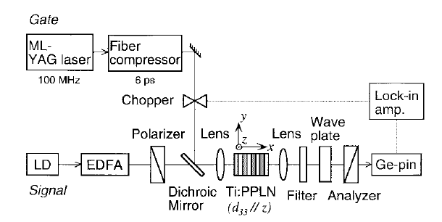

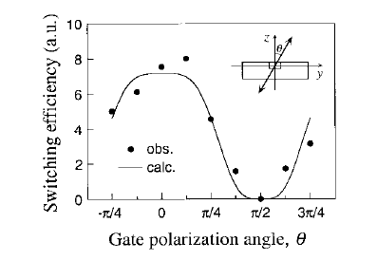
Motivation
H. Kanbara, H. Itoh, M. Asobe, K. Noguchi, H. Miyazawa, T. Yanagawa, I. Yokohama, “All-Optical Switching Based on Cascading of Second-Order Nonlinearities in a Periodically Poled Titanium-Diffused Lithium Niobate Waveguide”, IEEE Photonics Technology Letters , 11(3), 328 - 330, 1999

Slide 23










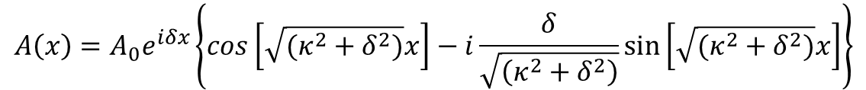


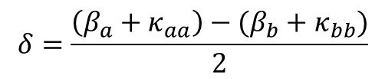
Directional coupler
Principle
$$P_{A}$$
$$P_{B}$$
$$A\left(x\right)=A_{0}e^{iδx}\left\{cos\left[\sqrt{(κ^{2}+δ^{2})}x\right]−i\frac{δ}{\sqrt{\left(κ^{2}+δ^{2}\right)}}sin\left[\sqrt{(κ^{2}+δ^{2})}x\right]\right\}$$
$$n_{2}$$
$$n_{2}$$
d
$$B\left(x\right)={−A}_{0}e^{−iδx}\frac{κ}{\sqrt{\left(κ^{2}+δ^{2}\right)}}sin\left[\sqrt{(κ^{2}+δ^{2})}x\right]$$
$$n_{1}$$
$$n_{1}$$
$$n_{1}$$
Coupled mode eq.
$$P_{A}\left(x\right)=A^{∗}A=P_{0}−P_{B}(x)$$
w
w
$$P_{B}\left(x\right)=B^{∗}B=P_{0}\frac{κ^{2}}{\left(κ^{2}+δ^{2}\right)}\sin^{2}\left[\sqrt{(κ^{2}+δ^{2})}x\right]$$
$${wg}_{a}$$
$${wg}_{b}$$
x
$$δ=\frac{\left(β_{a}+κ_{aa}\right)−(β_{b}+κ_{bb})}{2}$$
y

